Slide 1
New York City Taxi Analysis
Daniel Monahan

Slide 2
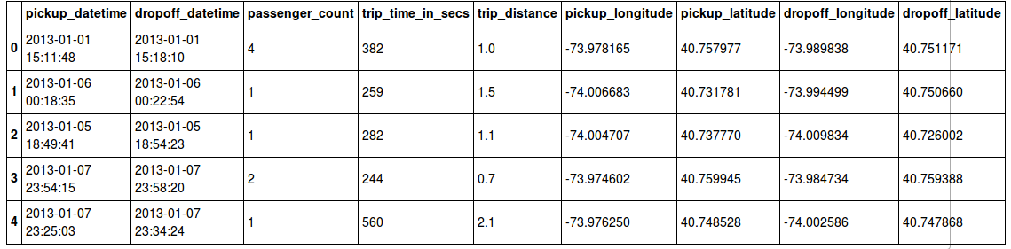
The Data
Taxi’s licensed by NY Taxi and Limousine Commission
January 1st 2013 - January 20th 2013
Pickup and Dropoff Coordinates, Pickup and dropoff datetime, Medallion and Hack #, distance and time of trip
Unique Medallions: 9120
Max Distance: 95.85 mi
Max Time: 10800 seconds
Mean # passengers: 2.1316
Mean distance: 2.93 mi
Mean trip time: 700 seconds
Average Hour of the day = 13 (1pm)
Median Speed = 12.36 mph
Obtained through a Freedom of Information Request by Chris Whong.
http://chriswhong.com/open-data/foil_nyc_taxi/

Slide 3
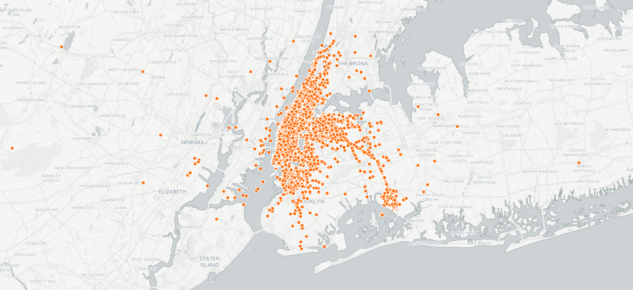
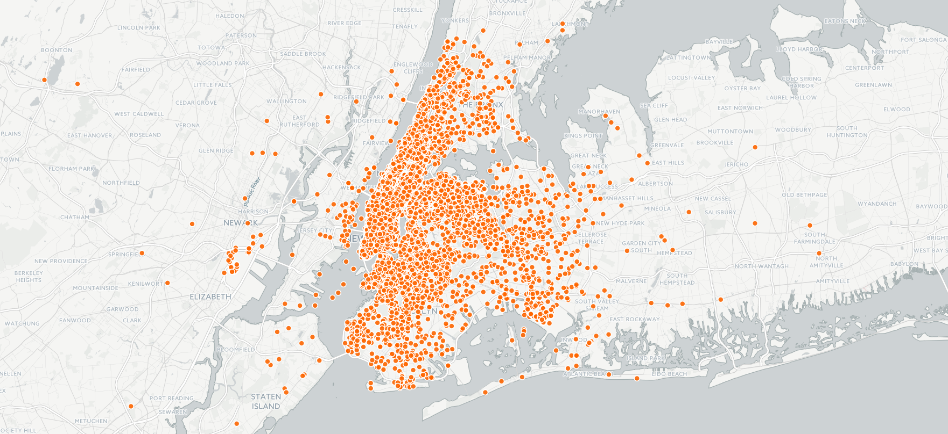
Pick Ups
Drop Offs
Notice the pick ups are largely focused on Manhattan and the downtown areas of Queens and Brooklyn, with some outliers (notably JFK airport). Southern Brooklyn and Eastern Queens are sparsely covered.
On the other hand, Drop offs are spread much more evenly throughout the entire city. Parts of the city like Southern Brooklyn and Eastern Queens are covered much more than in the Pick up map.
Are Outer Areas Underserved by Taxis? Taxis drop off in outer areas, but don’t pick up often.

Slide 4
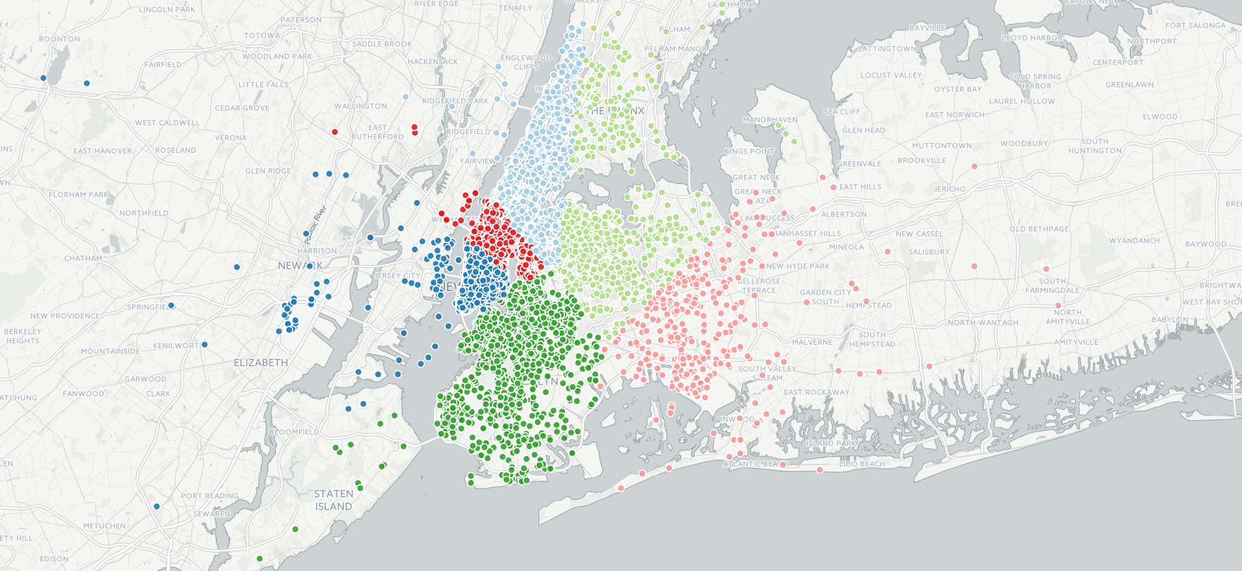
K-Means Clustering
Clustered based on Dropoff coordinates
Separates Brooklyn, Western Queens and Bronx, Eastern Queens, Lower Manhattan, Midtown, and Upper Manhattan
Using k-means clustering, with k = 6

Slide 5
Cluster Statistics
Cluster | Count | Avg Distance (mi) | Avg Time | Avg Passengers | Avg Mean Speed (mph)
Midtown | 41933 | 2.39 | 589s (9.82 min) | 2.16 | 13.68
Eastern Queens | 1512 | 14.63 | 1588s (26.47 min) | 2.22 | 33.27
Lower Manhattan | 25931 | 2.5 | 648s (10.80 min) | 2.13 | 13.27
Western Queens /Bronx | 3346 | 9.02 | 1208s (20.13 min) | 2.19 | 27.08
Upper Manhattan | 23715 | 2.52 | 552s (9.20 min) | 2.18 | 15.67
Brooklyn | 3563 | 6.31 | 1225s (20.42 min) | 2.14 | 18.15

Slide 6
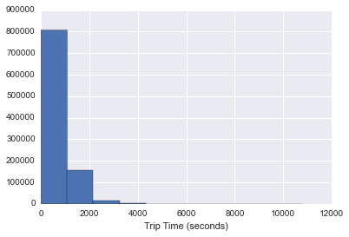
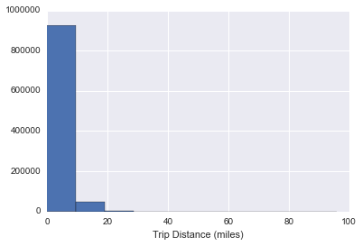
Trip Time and Distance
Trips Times Trip Distances
Trip Times and Distances heavily favor short trips
79.6 % of Trips are under 1000 seconds (16:40)
95% of Trips are under 10 miles

Slide 7
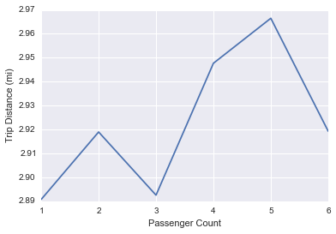
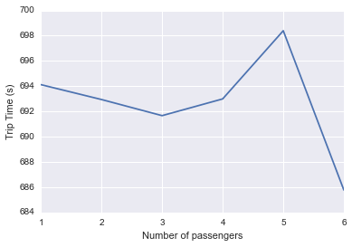
Trip Times and Distances vs Number of Passengers
Shortest distance trips are taken by single passengers and groups of 3
Longest trips taken by groups of 5
Although trips are longer distance for groups of 2, they take less time than single passengers.

Slide 8
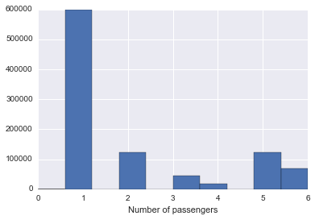
Number of Passengers
Large Majority of trips taken by single passengers
Could this be a default setting? Maybe not all trips accurately record # of passengers
Could sharing taxis help?

Slide 9
Taxi - pooling?
For random chunks of 1000, sorted by pickup date:
Computed the pairwise distances of the pickup and drop off coordinates
For each trip, count the number of other trips where the combined distance from pick up and drop off is under 1 mile
Compute the average number of potential trips that could be combined with each trip
Results:
01/13/2013 07:27:00 - 07:52:00 -- 13
01/13/2014 18:32:00 - 18:37:00 -- 21
01/15/2014 08:57:00 - 09:01:00 -- 36
01/16/2013 00:31:00 - 00:41:00 -- 17
Conclusion - The number of trips made with close pickup and dropoff points at similar times show that there is potential for sharing taxi rides.

